Slide 1
Implementing ETL Pipeline for Financial Data Sources
Muhammad Shoaib Khan
DS – 007 / 2021

Slide 2
What is ETL ?
ETL, which stands for extract, transform and load, is a data integration process that combines data from multiple data sources into a single, consistent data store that is loaded into a data warehouse or other target system.
As the databases grew in popularity in the 1970s, ETL was introduced as a process for integrating and loading data for computation and analysis, eventually becoming the primary method to process data for data warehousing projects.

Slide 3
What is ETL ?
ETL provides the foundation for data analytics and machine learning workstreams. Through a series of business rules, ETL cleanses and organizes data in a way which addresses specific business intelligence needs, like monthly reporting, but it can also tackle more advanced analytics, which can improve back-end processes or end user experiences.

Slide 4
Uses of ETL:
ETL is often used by an organization to:
Extract data from legacy systems
Cleanse the data to improve data quality and establish consistency
Load data into a target database

Slide 5
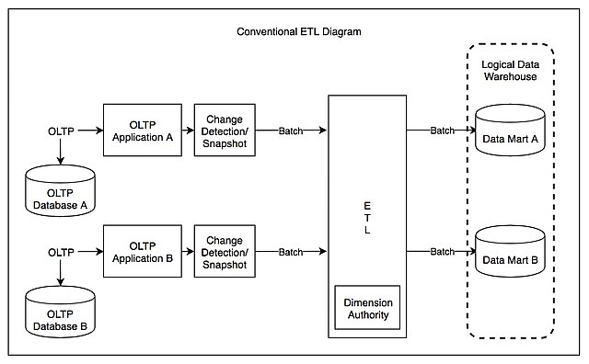
General Architecture of ETL:

Slide 6
ETL Process Description:
In computing, extract, transform, load (ETL) is a three-phase process where data is extracted, transformed (cleaned, sanitized, scrubbed) and loaded into an output data container. The data can be collated from one or more sources and it can also be outputted to one or more destinations. ETL processing is typically executed using software applications but it can also be done manually by system operators. ETL software typically automates the entire process and can be run manually or on reoccurring schedules either as single jobs or aggregated into a batch of jobs.

Slide 7
Data Source for ETL Project Pipeline:
https://www.bankofcanada.ca/valet/docs
The Bank of Canada Valet Web Services offers programmatic access to global financial data. By using the Valet API, you can retrieve financial data and information from the Bank of Canada — such as daily exchange rates of the Canadian dollar against the European euro.
Formats
We provide data in JSON, XML, and CSV formats.

Slide 8
Software Used in implementing this project:
Python
Microsoft VS CODE (Text Editor)
SQL Server 2019
Microsoft Power BI

Slide 9
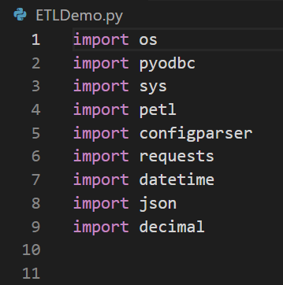
Libraries Used in this Project

Slide 10
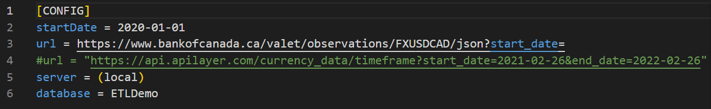
Implementation
Creating the configuration file:

Slide 11
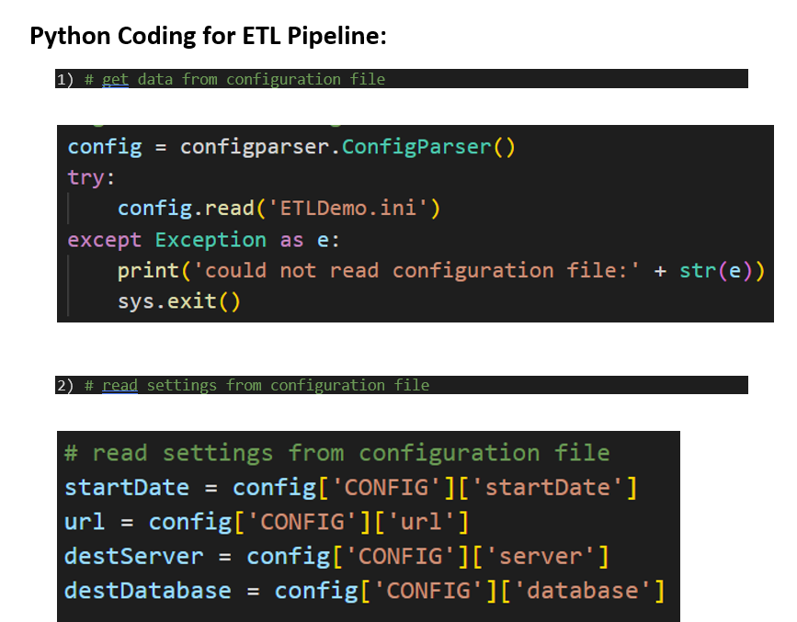
Implementation

Slide 12
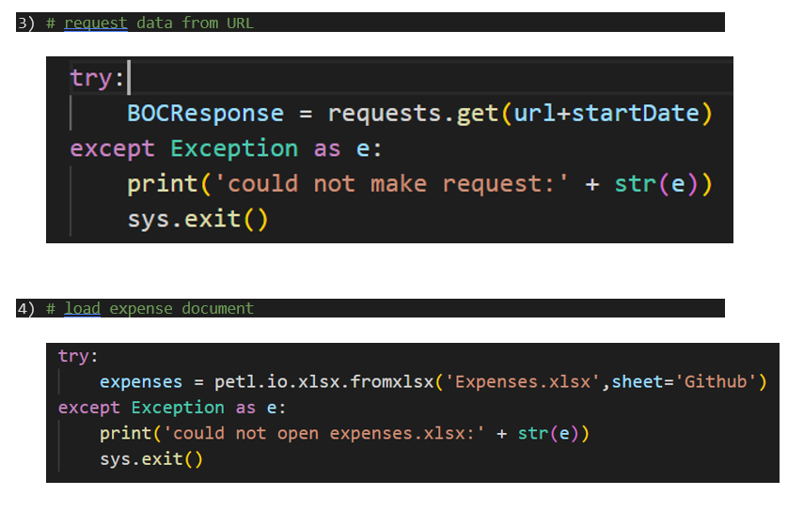
Implementation

Slide 13
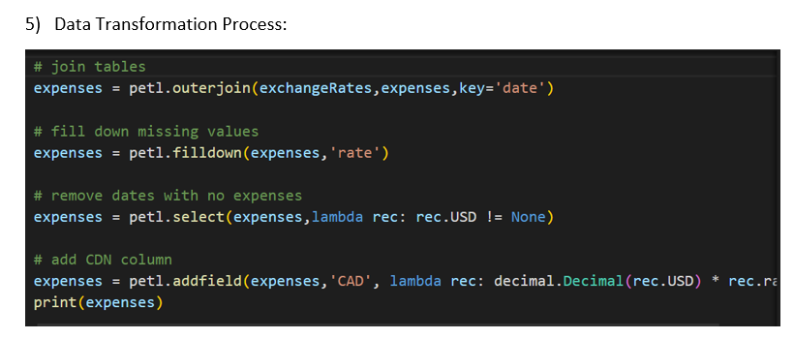
Implementation

Slide 14
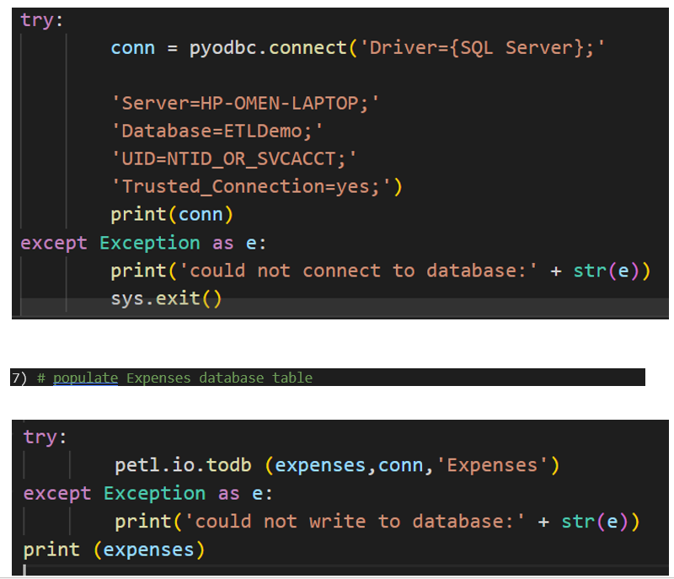
Implementation

Slide 15
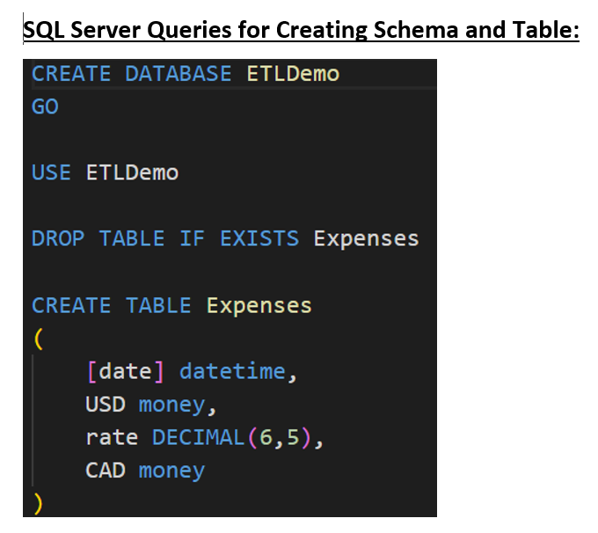
Implementation

Slide 16
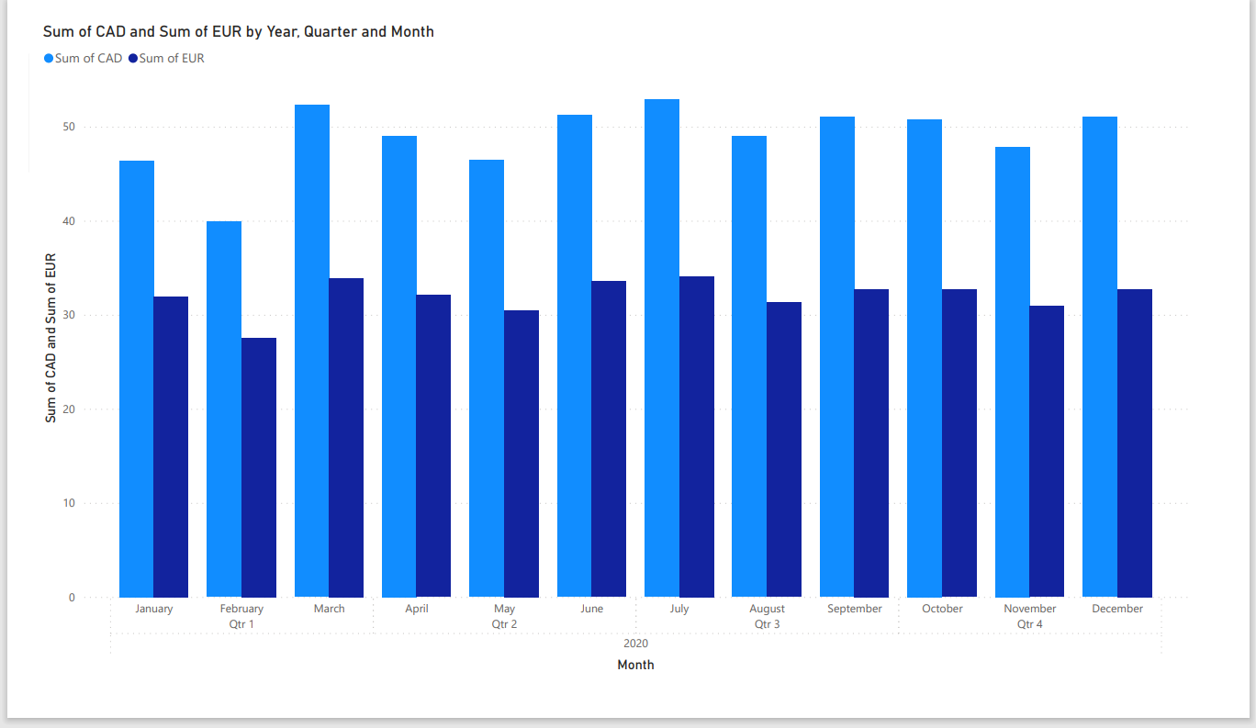
Power BI Visualization

Slide 17
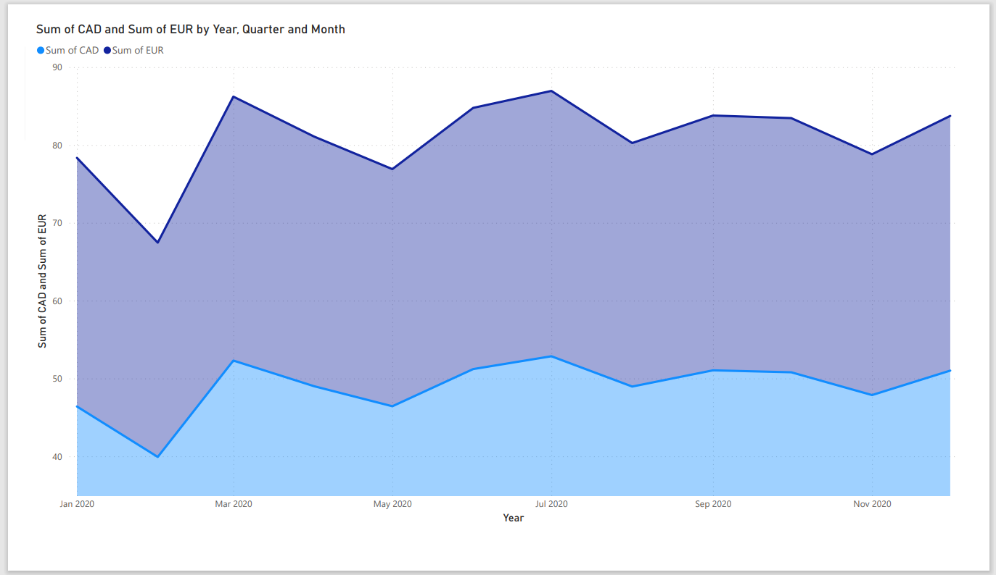
Power BI Visualization

Slide 18
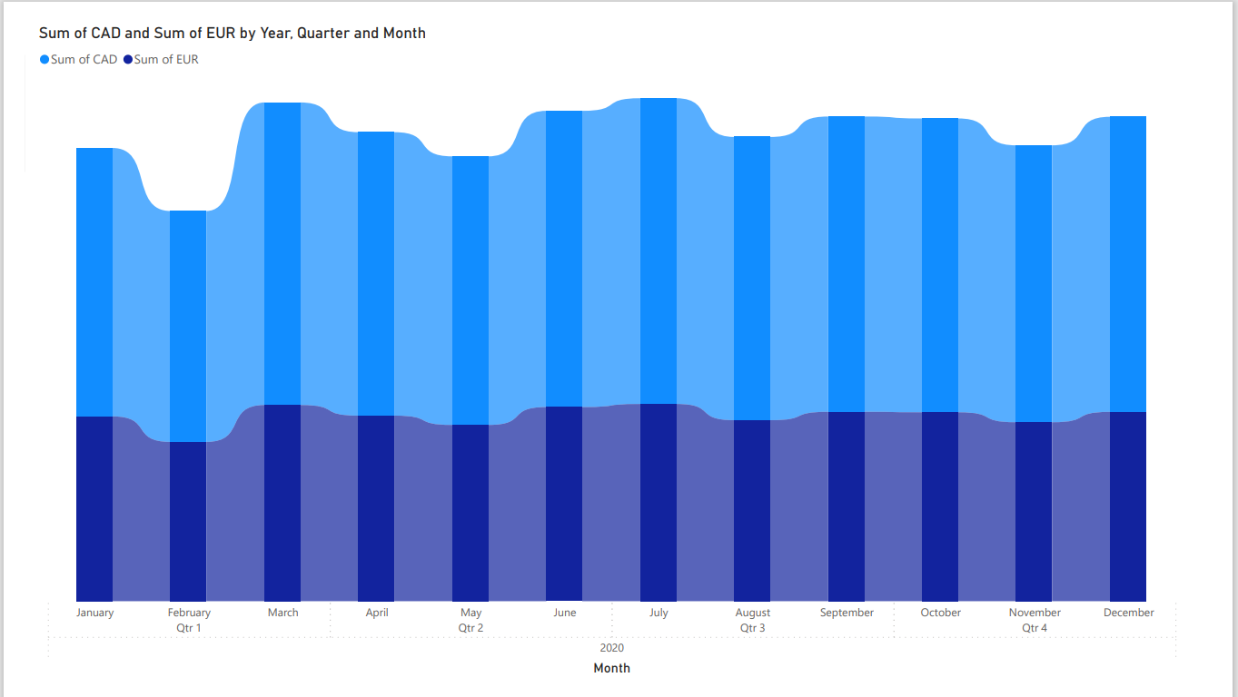
Power BI Visualization

Slide 19
Sources of Reference:
https://en.wikipedia.org/wiki/Extract,_transform,_load
https://xtract.io/blog/why-are-etl-tools-necessary-for-financial-data-analysis-and-reporting/
https://www.matillion.com/resources/blog/the-importance-of-etl-tools-in-data-warehousing

